Slide 1

Import/Export Tables
Professor Bo Liu
James Watt School of Engineering

Slide 2
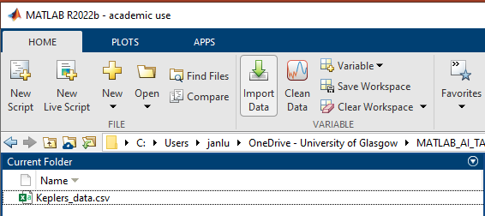
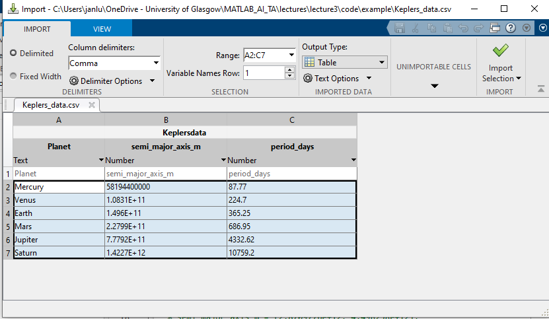
Import and Export to/from csv files via GUI
Steps to import data:
  Highlight file to import
  Press “Import data”
  3. This brings up the data importer app
Button used to import table
Data found by MATLAB

Slide 3
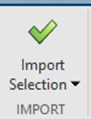

MATLAB data importer
If everything is as desired, then import using the import button
Name that will be assigned to table variable
These will be the column names
Datatypes found
“Planet” column of table
“semi_majoir_axis_m” column
“period_days” column
Table is now available as local variable “Keplersdata”

Slide 4
Import and Exporting to/from csv files in code
The readtable(path) can be used to read a file as a MATLAB table.
  The path variable should be a string specifying the absolute or relative path to the file.
The writetable(path) function can be used to save a MATLAB table as a csv file
Adding data for Uranus and Neptune (week 2 case study):
keplers_data = readtable("C:/data/Keplers_data.csv");
Planet = ["Uranus"; "Neptune"];
semi_major_axis_m = [2.8709776e+12; 4.498258e+12];
period_days = [30687.15; 60190.03];
new_data = table(Planet, semi_major_axis_m, period_days);
planetry_data = [keplers_data; new_data];
writetable(planetry_data, "planetry_data.csv")
See live script

Slide 5




Thanks!
#UofGWorldChangers
@UofGlasgow

